Slide 1



Academic mobility in Aalborg Bi-weekly presentation 12/02/2026
M.Sc. Papadopoulos Dimitrios

Slide 2
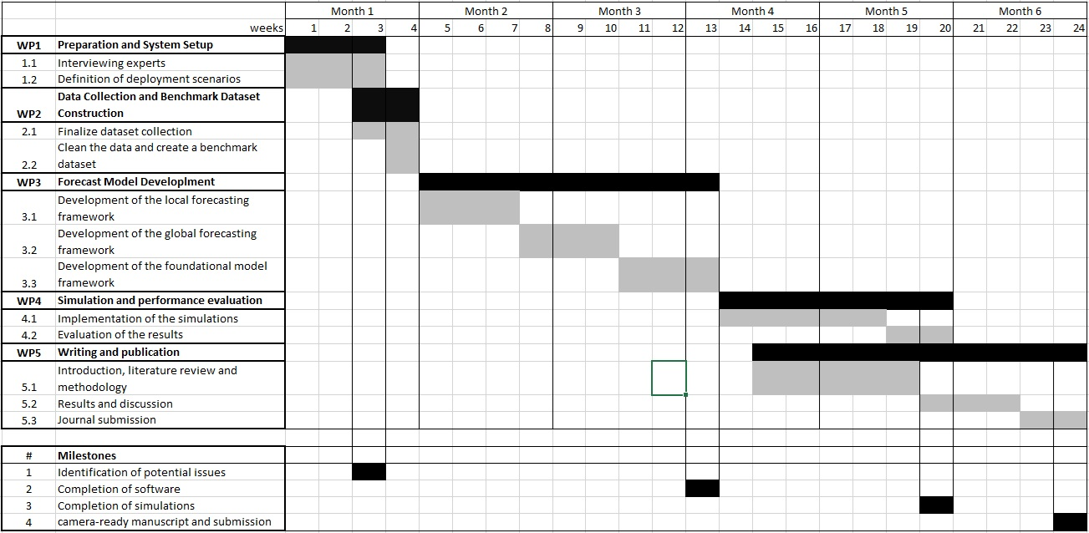
Schedule
Needs restructuring to fit into the 4.5 months timeframe

Slide 3
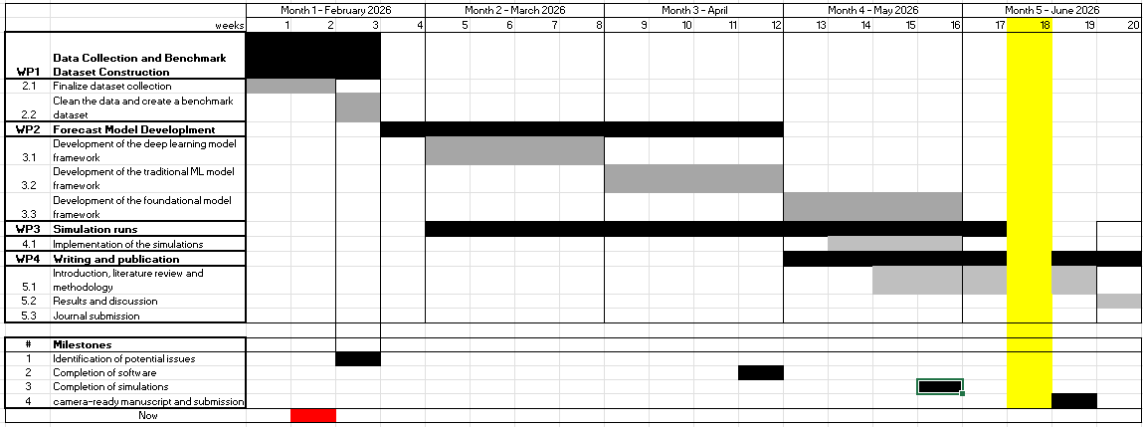
New Schedule
Needs restructuring to fit into the 4.5 months timeframe

Slide 4
Work
HBDs
Collection of 3 distinct datasets
Decided on the Architectures
Decided on the models
TODOs
Datasets from you
Collection of emails from the contributors to invite them in the overleaf project
Evaluation metrics
Work on the framework!
Notes:
Affected by the electricity market price! Feature eng
Grid tarriff dynamic
Scheduling for feature
Structure for benchmarking – test grid
6 o clock peak cooking

Slide 5




Architectures
Community 1
Community 2
Local model (train one model per household)
Global model (train one model with data from one community)
Cross learning (train one model with multiple communities)
Transfer learning (train one model on community 1 to predict community 2)
Zero shot models (one model pretrained)
Hierarchical reconciliation
+ ….
+ ….
 | Dataset1
HH1 | HH2 | HH3
 | Dataset 2
HH1 | HH2 | HH3

Slide 6
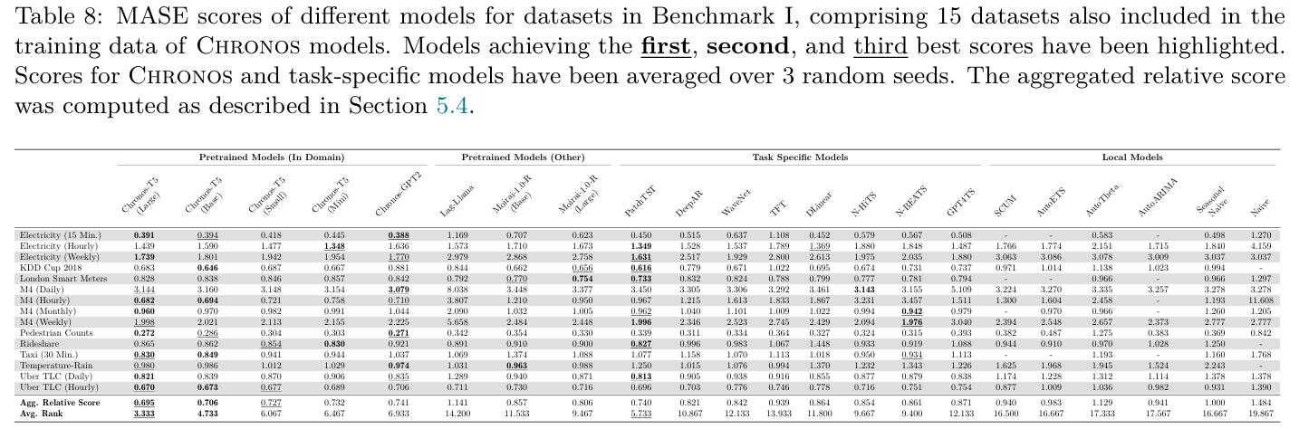
Evaluation metrics (what others are doing pt.1)
Chronos paper
https://arxiv.org/abs/2403.07815

Slide 7
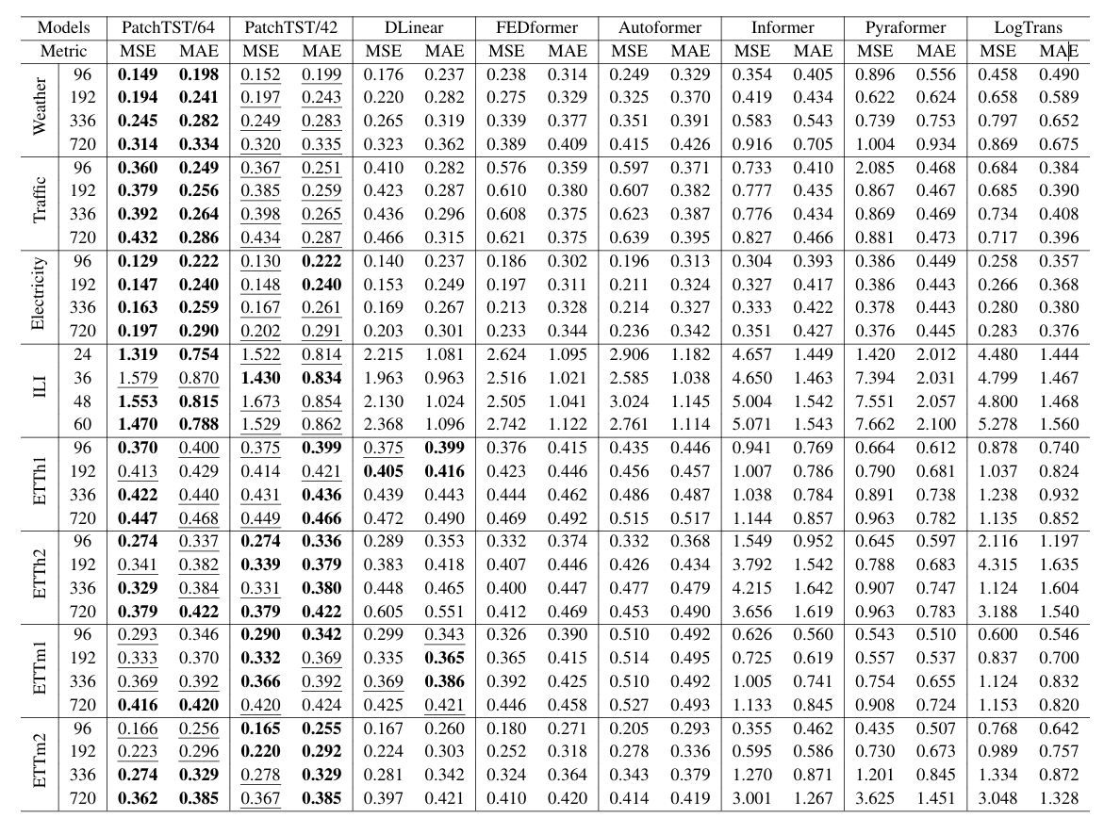
Evaluation metrics (what others are doing pt.2)
PatchTST paper
https://arxiv.org/abs/2211.14730

Slide 8
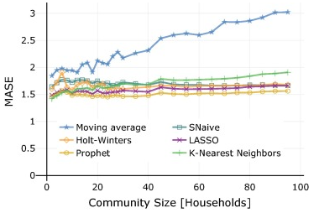
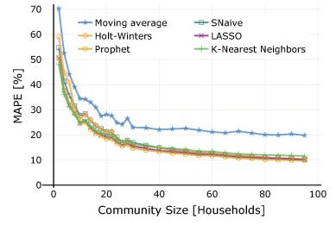
Evaluation metrics (what others are doing pt.3)
Evaluating forecasting methods in the context of local energy communities
https://www.sciencedirect.com/science/article/pii/S0142061521001964#f0015

Slide 9
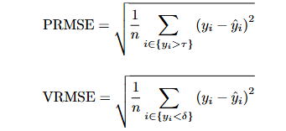
Evaluation metrics (open discussion)
I am comparing model accuracy across communities, that is why I need percentage metrics.
WAPE, nMAE,nRMSE,nPRMSE,nVRMSE,nXRMSE
How well can I make these metrics into community metrics?
Via averaging
Via weighted averaging
 | Dataset1
HH1 | HH2 | HH3
 | Dataset 2
HH1 | HH2 | HH3

Slide 10





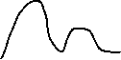

Whiteboard

Slide 11





Thank you for your attention!

